Slide 1
The best choice for your home sale
Jane Smith, Broker Associate

Slide 2
Overview
Get to know you better
Answer all your questions
Ask you important information
Determine if I am the agent for you

Slide 3
About me
John Smith, Broker Associate
Based in Denver, Colo.
Married to [wife/husband] [name] since [20xx]
Three children
Auto enthusiast, sailing, hiking, marathon running, etc.—list your hobbies
Add as many other bullet points about your personal background as you’d like to include!

Slide 4
About my business
1997
Graduated from Some Great University
1999
2000
Broker Associate at ABC Realty
2007
Top producer at ABC Realty
Received real estate license
Started own company, XYZ Realty
2015
Write a paragraph about your business. I’m a super great Realtor and you’re so going to want me to help sell your home! Aliquam ac urna eget mauris tempus gravida. Morbi aliquam dui eget egestas molestie. Nullam eros ligula, imperdiet suscipit viverra at, elementum eget velit. Sed purus mauris, sagittis vitae rutrum in, suscipit quis arcu.

Slide 5
Tell me about your house
In the next 20 minutes we’ll discuss:
What drew you to this home when you bought it?
What is your favorite feature of this house?
What do you like about your neighborhood?
What are some nearby attractions and amenities?
What don’t you like about it?

Slide 6
Important questions
Why are you moving?
How soon do you need to move?
What are you looking for from your agent?
Do you anticipate any major challenges with selling your home?
What will you do if your home doesn’t sell?
This information will help me determine the best course of action as we go through the process of selling your home.

Slide 7
Why I’m the best Realtor for you
My Unique
Selling Proposition
What really sets me apart from other agents is my [local market knowledge, my ability to communicate, my technology, etc.].

Slide 8
My Signature Approach
I believe in an upfront no-nonsense approach to selling real estate
I will tell you if either I or my company is not the best fit for your situation
I will be honest about the pricing of your property
STAYING ON TOP: I take quarterly classes to stay current with my industry … (rewrite with your own information).

Slide 9
Why I’m Different

Slide 10
What my clients are saying
Eric Sachs
Nathan Froelich
Ethan Conley
“John is a true professional. I’d recommend him to my friends and family in a heartbeat.”
“John guided us through the entire process. If we move again, John is the first person I’m calling. He’s the best Realtor in town.”
“John is a great real estate professional. His negotiation skills are the best in the business, and saved us a ton of money!

Slide 11
What does Realtor® mean?
Only Real Estate Agents who are members of the National Association of Realtors® can use this term.
Realtors subscribe to a higher code of ethics.
Realtors are required to have additional education.
I’m a member of the Local, State, and National Association.

Slide 12
About my organization
We service [CITY/NEIGHBORHOOD/ETC.)
We were established [DATE)
We are [LOCALLY OWNED, PHILANTHROPIC, ETC.)

Slide 13
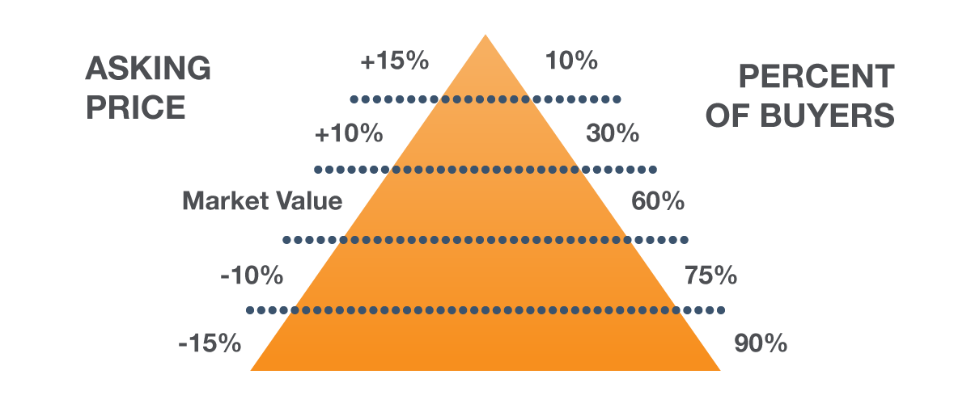
The Price Derivative
Every property will sell and has the potential to sell quickly, and the price is the No. 1 factor controlling this outcome.

Slide 14
Now, I want you to imagine …
… this is no longer your home. You have jumped forward in time and you now live in the home and the neighborhood where you plan on moving to next.

Slide 15
Competitive Market Analysis
[CHANGE SLIDE BACKGROUND PHOTO TO AN APPROPRIATE NEIGHBORHOOD]
Comparables include sales from all real estate agents and companies
I check public records in addition to MLS
The best measure of value is sold listings
Active listings demonstrate supply and competition
Withdrawn/expired listings usually demonstrate an overpriced listing.

Slide 16
Marketing your property
What’s Most Important
Marketing Methodology
The Digital Age

Slide 17
Marketing your property
Much of my marketing starts today, when we agree on a price for your home. The best marketing in the world will never sell an overpriced home.

Slide 18
Fact vs. Fiction
When it comes to online marketing, many agents will try to convince you they have the “secret sauce.”
The fact is, every agent’s listing is syndicated out by the MLS to hundreds, if not thousands, of web sites.
The truth: If a buyer is house shopping online and your home matches their criteria, it would be almost impossible for them not to find your home.

Slide 19
Marketing Channels
My brand has the following unique online marketing methods:
Brand website
Brand Advertising
I offer the following unique marketing methods:
Virtual Tours
Professional Photos
Yard Signs
1-800 Call Capture
Flyers
Social Media
Craigslist

Slide 20
Getting started
Getting started is easy. Once we have agreed on a price and I have answered all of your questions, we have a little paperwork to complete. Then I can have your home on the market in as little as 48 hours.

Slide 21
Thank you!
Selling your home is a big deal and I take the task very seriously. The fact that you have considered me to help you accomplish this means
the world to me!

Slide 22
My contact information
Cell: 555.555.555
Office: 444.444.4444
Email: yourname@gmail.com
Website: website.com
I always check my email and text
messages. I almost never answer the phone while showing clients homes but will check messages frequently.

