Slide 1
Facebook Cover Photo Trick
Building your brand

Slide 2
Social Media Branding
Re-enforce the visual and emotional anchors people associate with you as a real estate professional

Slide 3
Your Cover Photo Billboard
Highly visible online space
Cover photo updates have a high priority in the news feed

Slide 4
Step 1. Deciding what to create
Do you want to be passive or aggressive?
Do you want to create a call to action?
What message do you want to convey?

Slide 5
Passive Option
Make a simple statement
“I love Selling Real Estate”
“Proud to Serve My Clients Since 1998”
“I Believe In Home Ownership”
City skyline photos, state flag, your picture, your company logo, REALTOR logo.

Slide 6
Aggressive Options
Create a Call to Action
“Looking for the perfect home? I can help”
“List with me, experience the difference”
“Click here for my July incentive package”
“If your home won’t sell, I’ll buy it!”

Slide 7
The How-To’s
Add a LEARN MORE or CLICK HERE button to the cover photo
This creates a call to action for the viewer
By default anywhere the user clicks on the cover photo it will take them to “the description”

Slide 8
Cover Photo Description
Once the cover photo is clicked, this is the description

Slide 9
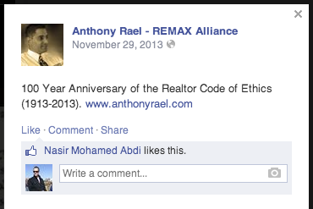
Cover Photo Description cont.
Edit description to reflect your message
Include web links to
your website
your home search tool
your FB Business Page

Slide 10
Examples

Slide 11
Examples

Slide 12
Conclusion
Your Cover Photo is highly visible
Creates an opportunity for “Top of Mind” marketing
Low cost strategy
Update often
Be sincere and honest

Slide 13
Branding is like planting a tree, the best time to do it was 10 years ago. The next best time to do it is RIGHT NOW.

Slide 14
Resources
Check out PageModo.com for an online custom cover photo maker
And TimelineCoverPhotoMaker.com

